Slide 1
Topics to be covered
Actuator
Types of Actuator
Convergence of Domains
IoT Components
IoT Interdependencies
IoT Categories
IoT Gateways
IoT and associated technologies
IoT Challenges
Complexity of Network

Slide 2
Actuator:
Actuator is the mechanism by which a control system acts upon an environment.
Types of Actuator:
Hydraulic
Pneumatic
Electrical
Thermal/ Magnetic
Mechanical
Soft

Slide 3
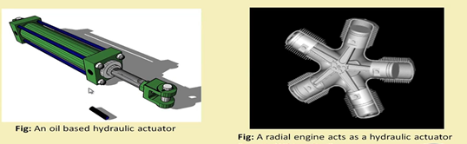
Hydraulic Actuator

Slide 4
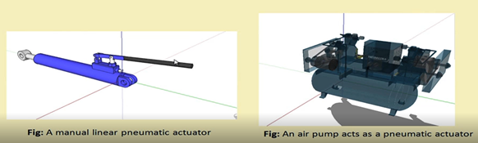
Pneumatic Actuator:

Slide 5
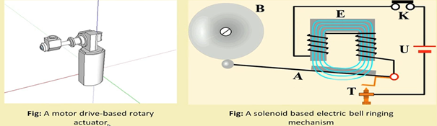
Electrical Actuator:

Slide 6
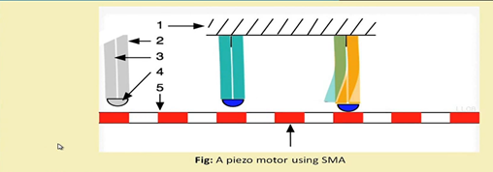
Thermal Actuator:

Slide 7
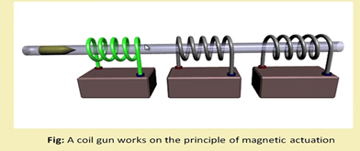
Magnetic Actuator:

Slide 8

Mechanical Actuator:

Slide 9
Soft Actuator:
Soft Actuator are designed to handle fragile object like fruit harvesting in agriculture or manipulating the internal organs in biomedicine.
Shape memory polymer
Light activated polymer

Slide 10
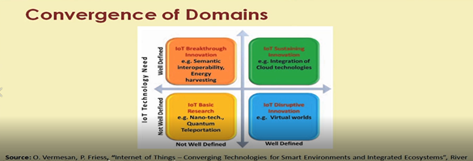
Basics of IoT Networking

Slide 11
IoT Components:
Device(the thing)
Local Network
Internet
Backend Services
Applications

Slide 12
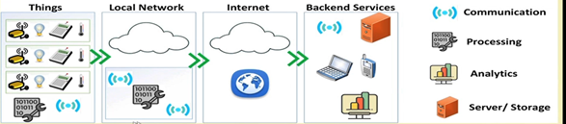

Slide 13
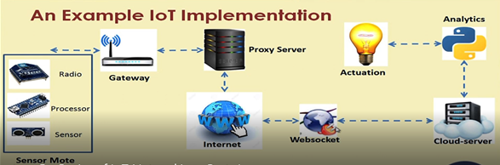

Slide 14
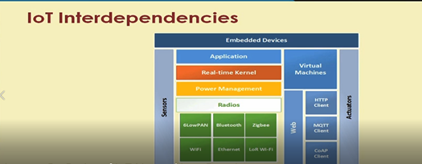

Slide 15
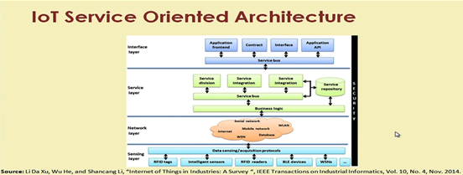

Slide 16
IoT Categories:
Industrial IoT
Consumer IoT

Slide 17
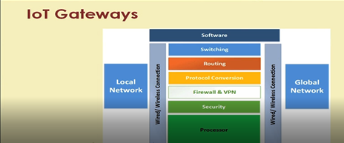
An IoT Gateway is a solution for enabling IoT communication, usually device -to-device communications or device-to-cloud communications. The gateway is typically a hardware device housing application software that performs essential tasks.

Slide 18
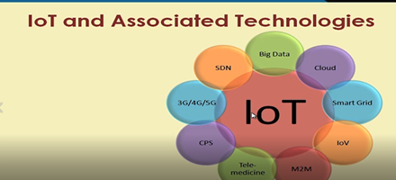

Slide 19
IoT Challenges:
Security
Scalability
Energy Efficiency
Modeling and Analysis
Data Storage
Data Analytics
Complexity Management

Slide 20
Complexity of the network:
Growth of Networks
Interference among devices
Network management
Heterogeneity in Network

